Slide 1
Image processing with EBImage (and ImageJ)
David Ornelles
R Users Group of Winston-Salem
December 11, 2017
Notes:
ImageJ can be downloaded from the NIH website: https://imagej.nih.gov/ij/download.html
R can be downloaded from the Comprehensive R Archive Network: https://cran.r-project.org/
Both ImageJ and R are packaged in what can be a more user-friendly, integrated development environment or IDE. These environments are excellent for learning and can provide many more integrated features. Personally, I find they tend to more delicate and are likely to fail with incompatible components when everything is not maintained and updated on a regular basis. I also prefer to have greater control over the software.
For ImageJ, the package wrapping is Fiji:
https://fiji.sc/
For R, the popular IDE is RStudio:
https://www.rstudio.com/products/rstudio/download/

Slide 2
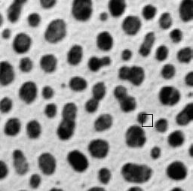

Basic Digital Image
64 | 56 | 48 | 48 | 72 | 104 | 136 | 176 | 192 | 208 | 208 | 216 | 208
56 | 56 | 48 | 40 | 72 | 104 | 136 | 176 | 192 | 216 | 216 | 216 | 208
48 | 48 | 40 | 40 | 72 | 104 | 136 | 168 | 192 | 208 | 208 | 216 | 208
48 | 40 | 40 | 48 | 72 | 104 | 136 | 168 | 184 | 208 | 208 | 216 | 208
40 | 40 | 48 | 56 | 88 | 120 | 144 | 168 | 184 | 208 | 208 | 216 | 208
40 | 40 | 48 | 64 | 96 | 136 | 152 | 168 | 192 | 216 | 216 | 216 | 216
32 | 40 | 56 | 72 | 104 | 144 | 160 | 184 | 200 | 216 | 216 | 216 | 216
32 | 40 | 56 | 80 | 112 | 152 | 176 | 208 | 216 | 224 | 224 | 224 | 216
40 | 48 | 72 | 96 | 128 | 168 | 192 | 216 | 216 | 224 | 224 | 224 | 216
48 | 64 | 88 | 120 | 152 | 184 | 200 | 224 | 224 | 224 | 224 | 224 | 224
88 | 104 | 128 | 152 | 176 | 200 | 208 | 224 | 216 | 216 | 216 | 216 | 216
128 | 152 | 168 | 184 | 200 | 216 | 216 | 224 | 216 | 216 | 208 | 208 | 208
160 | 176 | 184 | 200 | 208 | 216 | 216 | 216 | 208 | 200 | 200 | 200 | 208
192 | 208 | 208 | 216 | 216 | 224 | 216 | 216 | 200 | 192 | 192 | 200 | 200
200 | 216 | 216 | 216 | 216 | 216 | 216 | 208 | 200 | 192 | 200 | 200 | 200
“Blobs” sample image
from ImageJ

Slide 3
Digital Image and Bit Depth
Each cell in the two-dimensional array of numbers that we interpret as an image is known as a pixel.
Each pixel is limited to a given range of values.
These values are often integers expressed as a binary number.
The bit-depth is log₂ of the possible values:
8-bit: 2⁸ = 256 16-bit: 2¹⁶ = 65,536
12-bit: 2¹² = 4,096 53-bit: 2⁵³ = (double precision)
EBImage uses double precision or real numbers.

Slide 4
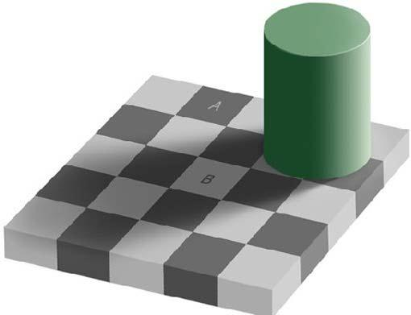
How good are your eyes?
Compare the gray level in the squares labeled “A” and “B”

Slide 5
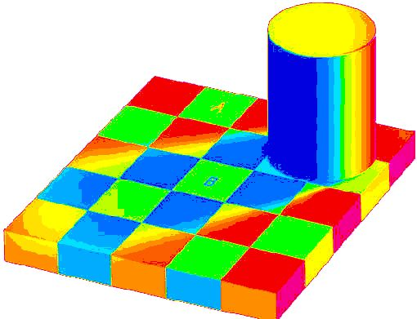
Pseudocoloring reveals surprise
Change in the look-up table (LUT)
.
.
.
A and B have the same gray level (intensity)

Slide 6
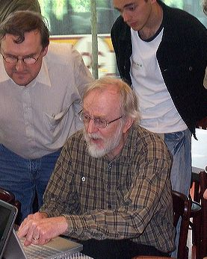
Tools for quantitative image analysis
ImageJ
Java-based image processing program developed at the National Institutes of Health by Wayne Rasband.
Open source, software package fully extensible with Java and a Java script-like macro programming language
EBImage
Package in Bioconductor runs under R (Gregoire Pau, Florian Fuchs, Oleg Sklyar, Michael Boutros and Wolfgang Huber)
http://www.optinav.com/Bob_ImageJ_Conference_Photos/source/100_0200.htm

Slide 7
Typical Image Work Flow
Read image
TIFF, PNG or JPEG format
Perform low level processing
Brightness/contrast, noise, linear, and non-linear filters
Feature identification
Lump related pixels together to define "objects"
Feature measurement
Presence or absence, shape, intensity, moments, textures...
Feature analysis
This is an activity R is very well suited for

Slide 8
Low level processing
Brightness & contrast
Kernel filters
3x3 Median filter replaces each pixel with the median of the 9 pixels neighboring pixels
Gaussian filter is something of a distance-weighted average
Other spatial filters perform similar smoothing operations or enhance edges in one direction or another or enhance changes in values

Slide 9


Low level processing: 3 x 3 median filter (non-linear)
28 | 27 | 60 | 48 | 79 | 114 | 152 | 186 | 184 | 207 | 212 | 210 | 226
27 | 28 | 62 | 51 | 80 | 113 | 156 | 186 | 184 | 208 | 211 | 213 | 215
16 | 15 | 39 | 61 | 82 | 116 | 151 | 157 | 187 | 208 | 211 | 207 | 206
70 | 57 | 24 | 72 | 80 | 130 | 163 | 187 | 196 | 203 | 194 | 222 | 2
23 | 28 | 63 | 54 | 114 | 138 | 175 | 213 | 207 | 216 | 224 | 246 | 224
43 | 51 | 76 | 6 | 126 | 173 | 186 | 217 | 213 | 225 | 235 | 231 | 212
73 | 74 | 84 | 112 | 173 | 182 | 210 | 212 | 214 | 212 | 237 | 195 | 204
99 | 93 | 96 | 149 | 185 | 187 | 213 | 229 | 229 | 216 | 219 | 14 | 188
147 | 137 | 176 | 177 | 220 | 209 | 233 | 246 | 223 | 200 | 215 | 208 | 201
169 | 175 | 255 | 12 | 208 | 190 | 195 | 225 | 213 | 173 | 196 | 198 | 211
208 | 215 | 211 | 211 | 207 | 230 | 227 | 216 | 216 | 13 | 186 | 191 | 188
237 | 232 | 217 | 217 | 211 | 218 | 207 | 209 | 200 | 191 | 189 | 176 | 167
230 | 220 | 220 | 219 | 213 | 228 | 206 | 193 | 196 | 191 | 191 | 193 | 211
28 | 28 | 48 | 60 | 79 | 114 | 152 | 184 | 186 | 207 | 210 | 211 | 213
28 | 28 | 51 | 61 | 80 | 114 | 152 | 184 | 187 | 207 | 208 | 211 | 212
28 | 43 | 54 | 63 | 80 | 126 | 157 | 186 | 196 | 207 | 208 | 211 | 212
39 | 51 | 60 | 72 | 112 | 138 | 173 | 186 | 207 | 208 | 211 | 211 | 212
43 | 61 | 70 | 80 | 114 | 156 | 182 | 194 | 210 | 212 | 212 | 212 | 212
70 | 72 | 74 | 93 | 130 | 173 | 187 | 210 | 212 | 213 | 212 | 212 | 208
74 | 84 | 96 | 114 | 173 | 185 | 207 | 212 | 213 | 213 | 212 | 212 | 211
99 | 99 | 137 | 173 | 182 | 190 | 212 | 213 | 213 | 213 | 212 | 208 | 204
147 | 149 | 173 | 182 | 195 | 209 | 210 | 213 | 213 | 212 | 208 | 201 | 201
175 | 177 | 207 | 208 | 211 | 211 | 210 | 210 | 209 | 208 | 200 | 196 | 195
211 | 211 | 211 | 211 | 213 | 213 | 211 | 207 | 200 | 196 | 196 | 193 | 191
220 | 219 | 218 | 217 | 215 | 213 | 209 | 206 | 196 | 193 | 193 | 193 | 193
220 | 220 | 220 | 219 | 217 | 213 | 207 | 206 | 193 | 193 | 193 | 193 | 193
median of 176, 177, 220, 255, 12, 208, 211, 211, and 207 = 208

Slide 10
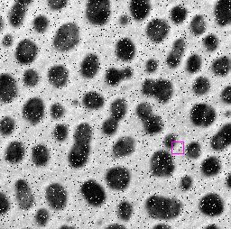
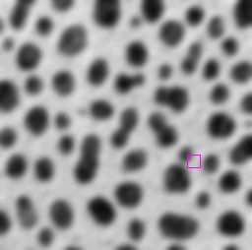

Low level processing: Gaussian blur (low pass filter)

Slide 11

Feature identification
Define the blobs
“Blobs” sample image
from ImageJ
Notes:
The key to most image processing problems is to identify the features of interest.
This amounts to determining which pixels are "features" and then which groups of pictures are related as a single "object."
In this example, we would be interested in identifying the dark blobs and then possibly counting them or measuring the area of each.

Slide 12
Talk Outline
Base R featured:
locator() mtext()
lapply() apply()
mapply()
...and not a mention of ggplot or lattice!
EBImage
Installation
Reading and displaying image
Standard Image Manipulation (*Interactive with R)
Brightness - Contrast
Gamma adjustment - Cropping*
Scaling* - Spatial transforms*
Filtering - Threshold
Vacation photo example
Real world case studies (with limitations to EBImage)
Straighten, crop and label RNA gel
Perform flatfield correction on noisy microscope images
Segment and classify images of sea urchin embryos
Contour map homework assignment
Virus titer from two-color fluorescent micrographs

Slide 13
Resources
EBImage
https://www.bioconductor.org
Search for EBImage
ImageJ website
https://imagej.nih.gov/ij/

